Slide 1
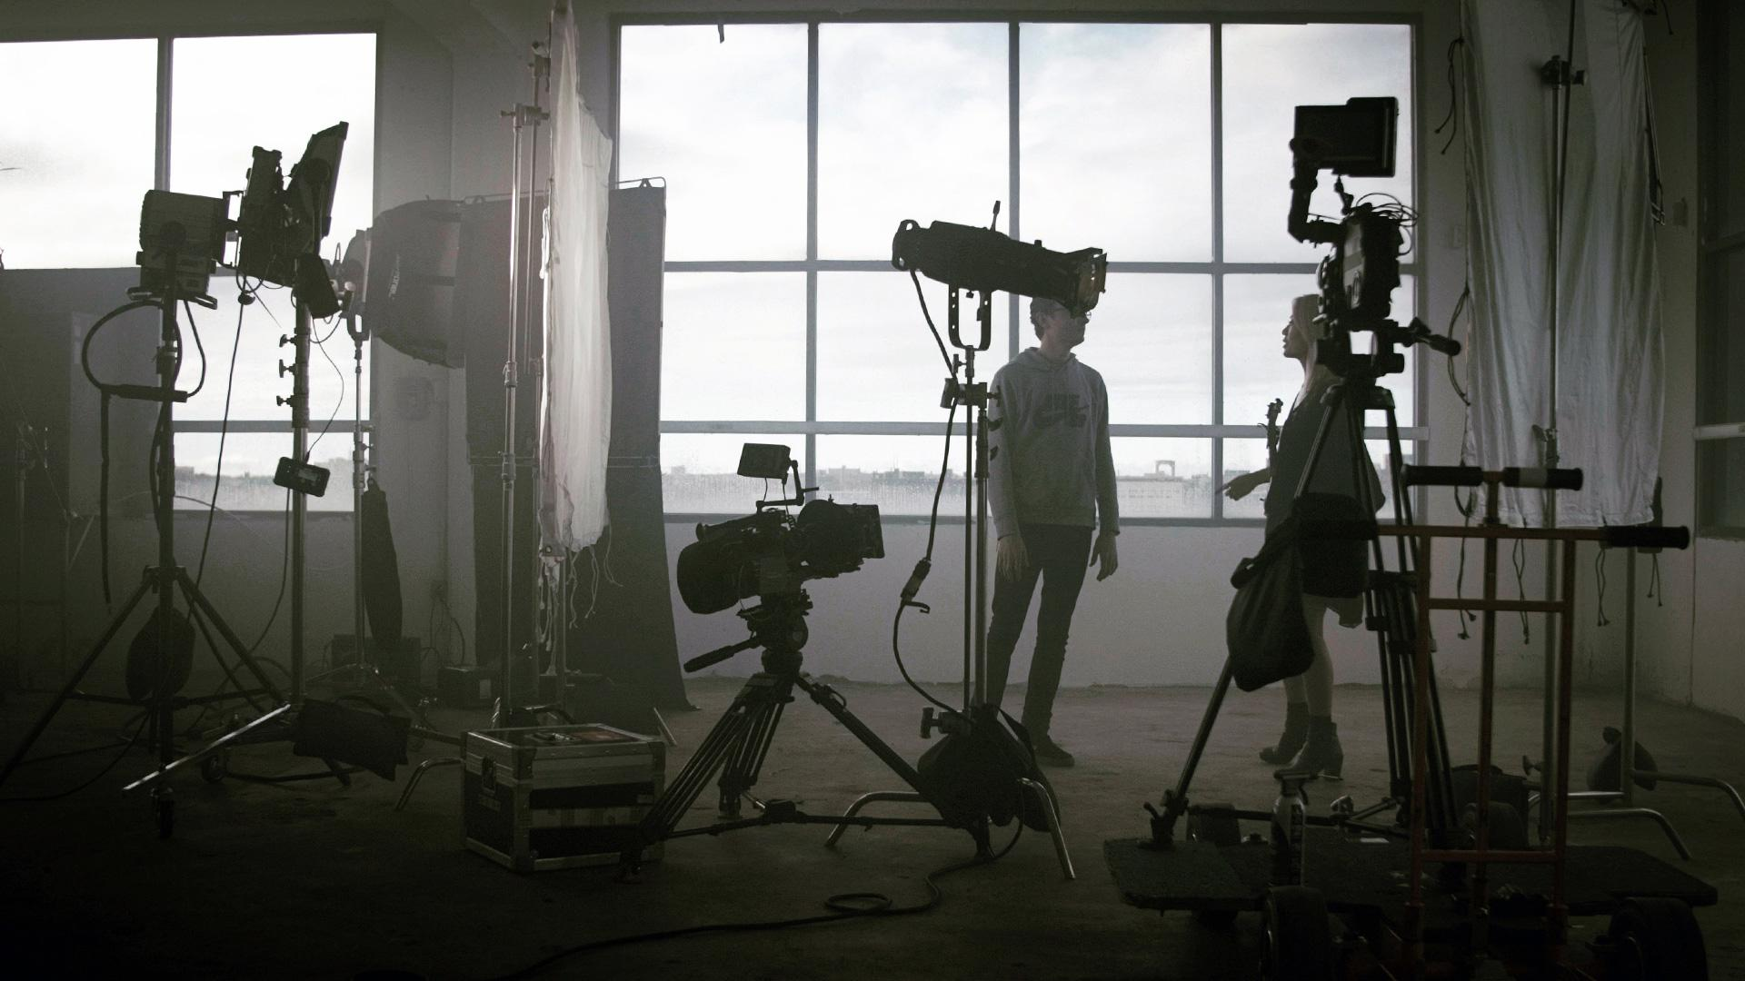
Songs Category
Company Name – Presenter of Idea
Please Ensure Providing All Required Information

Slide 2
1
Song Title
8
Music sample
2
Song Concept copyrights Company Name – Individual
9
Filming Locations
3
Song Layout
10
Production Technical Equipment Example (Camera Type, Lighting, Editing and Coloring software)
Songs Category
Form
Contents
11
4
Song Lyrics
Attachments
(pictures, Videos, links, references)
5
12
Marketing Plan
Production Plan
6
13
Financial Plan (Estimated Cost)
Production Crew
7
Proposed Singer
Please Ensure Providing All Required Information
2

Slide 3
Brief about Company or Idea Presenter
Example:
Years of experience, previous work, fields of work, etc.. Please write suggested text here
Song’s Concept and What are the aspects of innovation and creativity in the concept of the song?
Example:
Please explain the idea of the song and what makes it unique.

Slide 4
Song title – Proposed Singer – Layout – Duration:
Example:
Several titles can be proposed with specifying the song’s layout and genre (National, youth, kids, etc.. ) and determine the proposed duration.

Slide 5
Song Lyrics
Examples
Add the song lyrics here.

Slide 6
Production Plan
Example:
Outline the proposed production and filming plan.

Slide 7
Proposed Filming Locations
Examples
Outline proposed filming locations here, if any
Production Technical Equipment
Example
What are the technical requirements for filming and overall production?

Slide 8
Proposed Production Crew
Role | Name

Slide 9
Financial Plan and Estimated Production Budget
Cost | Particulars
 | Total Cost

Slide 10
Song Marketing Plan
Example:
Outline your suggested marketing plan to promote your production

Slide 11
Attachments

Slide 12
Attachments
Example:
Add any pictures, videos, links or references that clarify your proposed idea.

Slide 13
Attachments
Example:
Add any pictures, videos, links or references that clarify your proposed idea.

Slide 14
Attachments
Example:
Add any pictures, videos, links or references that clarify your proposed idea.

Slide 15
Attachments
Example:
Add any pictures, videos, links or references that clarify your proposed idea.

